Slide 1
Community Based Agriculture: Small Lots, Big Impact
Conservation in the Classroom Agroecology + Innovation Matters

Slide 2
Lesson Plan and Supplemental Materials
Lesson Plan
Small Lots: Big Impacts Worksheets
Supplemental 1: Community Assignments

Slide 3
Scenario 1a
You went to school all day and then worked extra hours at your part-time job. After work you need to pick up toppings to make a homemade pizza for dinner. You would like to have fresh green peppers, mushrooms, and fresh jalapeños for toppings, but the closest grocery store with produce is over 10 miles away one-way and you have a tight budget for fuel (and you’re tired from your long day!). There is a convenience store that you drive by on your way home that carries some pre-packaged grocery items like packaged pepperoni, canned pineapple, and bacon. Do you drive 20+ miles round-trip to pick up fresh toppings from the grocery store or swing by the store that’s on your way home and pick up the convenient options?

Slide 4
Scenario 1b
You went to school all day and then worked extra hours at your part-time job. After work you need to pick up toppings to make a homemade pizza for dinner. You would like to have fresh green peppers, mushrooms, and fresh jalapeños for toppings, but the closest grocery store with produce is over 1 mile away one-way and would require you to either walk or take 2 buses to get there, and you are tired from your long day. There is a convenience store that you pass by on your way home that carries some pre-packaged grocery items like packaged pepperoni, canned pineapple, and bacon. Do you walk or bus the 2+ miles to pick up fresh toppings from the grocery store or swing by the store that’s on your way home and pick up the convenient options?

Slide 5
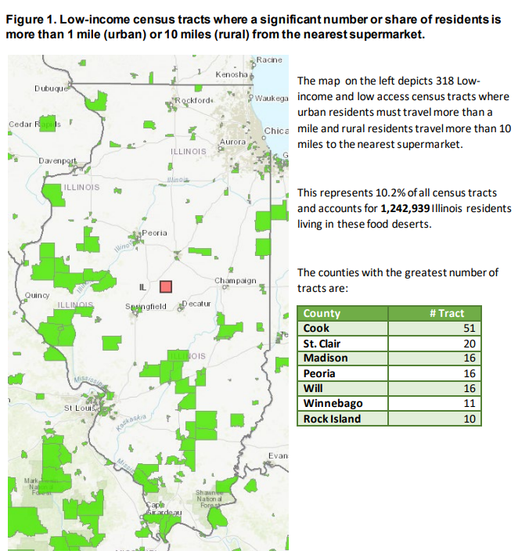
A food desert is “a location lacking fresh fruit, vegetables, and other healthful whole foods, in part due to a lack of grocery stores, farmers' markets, or healthy food providers.” (IDPH, 2019)
IDPH, 2019

Slide 6
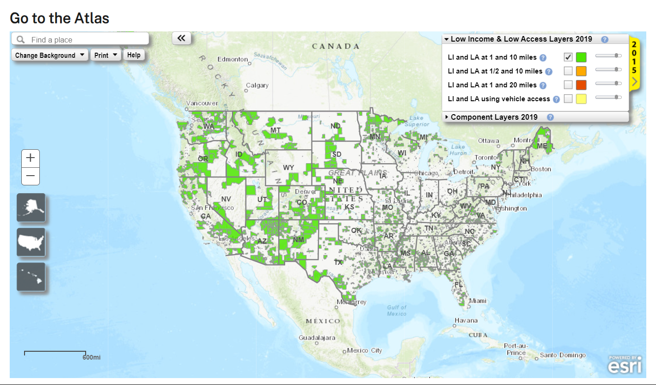
USDA Food Access Research Atlas
Go to http://tinyurl.com/atlasusda
5 minutes to explore the map on own

Slide 7
Paris, IL
Click video to play.

Slide 8
Paris, IL
 | Paris, IL | State of IL
Population: | 8,291 | 12,812,508
Median Age: | 41.8 | 39.1
Median Household Income: | $50,800 | $76,708
Industry: Agriculture, forestry, fishing and hunting, and mining | 0.2% | 1.1%
Click video to play.

Slide 9
Small Lots: Big Impacts #1
Now it’s your turn!
Draw a community at random.
Go to data.census.gov.
Search for your community & select “Profile”
Use the information under “Profile” to answer the questions on page #1 of the Small Lots: Big Impacts worksheet.

Slide 10
Small Lots: Big Impacts #2
Review at least 2 of the articles on page #2 of your worksheet.
Answer the questions in “Step 2”. Remember, these are not “right” or “wrong” questions, but you should create a definition and think critically to provide useful answers.

Slide 11
Small Lots: Big Impacts #2
What are some of the potential obstacles and solutions that you came up with in question #3?

Slide 12
Small Lots: Big Impacts #3
Let’s look at the local ordinances in Paris, IL. Let’s begin by searching for “garden”.
Click video to play.

Slide 13
Small Lots: Big Impacts #3
There are a lot of results, and a term that seems to be present in all of them is “Truck Gardening.” But what does that mean?
We need to look at the “definitions” section for clarification before reading the code.
ARTICLE II: DEFINITIONS (62) TRUCK GARDENING. The cultivation, harvesting and sale of perishable, edible produce for commercial enterprise.

Slide 14
Small Lots: Big Impacts #3
Now that we know what truck gardening means, and that it seems to fit with what we are looking to do, let’s search for “truck gardening” to read the actual code.
ARTICLE V: R-1 AND R-2 SINGLE-FAMILY RESIDENCE DISTRICTS
§ 2. USE REGULATIONS. A building or premises shall be used only for the following purposes:
(1) One-family dwelling.
(2) Truck gardening and farming outside the corporate limits.
Continued.

Slide 15
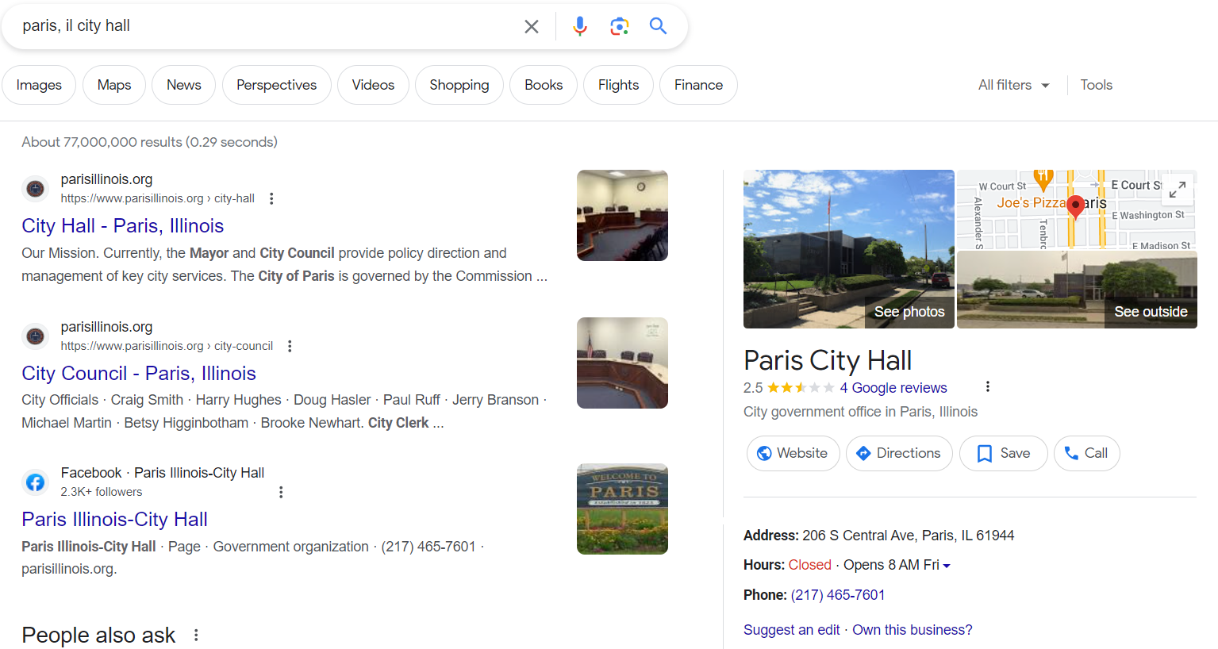
Small Lots: Big Impacts #3
Armed with this information, we can confidently contact city hall and:
Explain the purpose of the project
Confirm that the community farm would be allowable under the truck gardening regulation under Article V, Section 2, Paragraph 2.

Slide 16
Reflect
Share what you discovered about ordinances in your assigned community.
What did you find out?
What questions do you still have?
What observations do you have on this process?
What could your next steps be in launching a community based farming operation?

